Slide 1
keras
Learn TensorFlow 2.0
Implement Machine Learning
and Deep Learning Models
with Python
By Pramod Singh
Avinash Manure

Slide 2
Why is keras
Keras is an API designed for human beings, not machines. Keras follows best practices for reducing cognitive load: it offers consistent & simple APIs, it minimizes the number of user actions required for common use cases, and it provides clear and actionable feedback upon user error.
This makes Keras easy to learn and easy to use. As a Keras user, you are more productive, allowing you to try more ideas than your competition, faster -- which in turn helps you win machine learning competitions.
This ease of use does not come at the cost of reduced flexibility: because Keras integrates with lower-level deep learning languages (in particular TensorFlow), it enables you to implement anything you could have built in the base language. In particular, as tf.keras, the Keras API integrates seamlessly with your TensorFlow workflows.

Slide 3
Why is keras
Keras development is backed primarily by Google, and the Keras API comes packaged in TensorFlow as tf.keras. Additionally, Microsoft maintains the CNTK Keras backend. Amazon AWS is developing MXNet support. Other contributing companies include NVIDIA, Uber, and Apple (with CoreML).
With over 200,000 individual users as of November 2019, Keras has stronger adoption in both the industry and the research community than any other deep learning framework except TensorFlow itself (and Keras is commonly used in conjunction with TensorFlow).

Slide 4
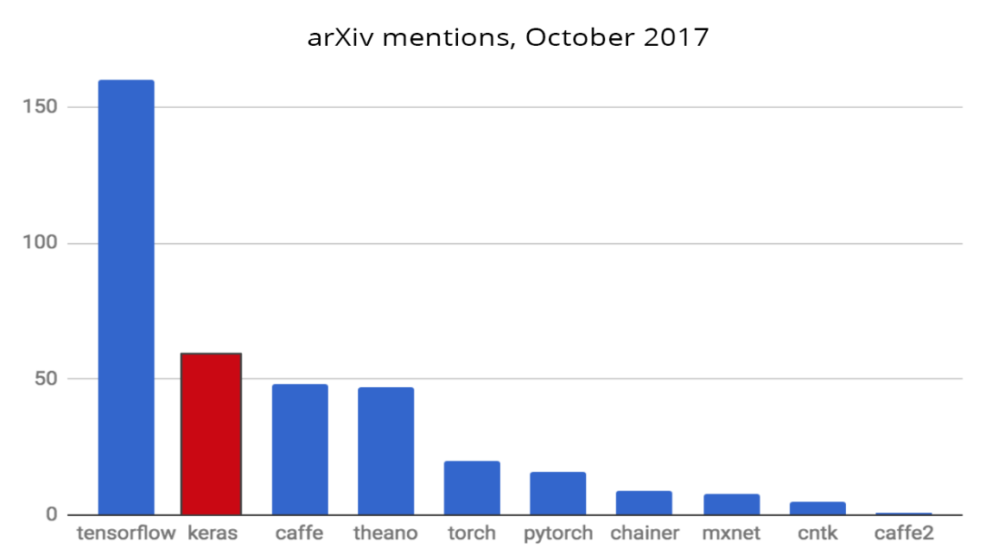
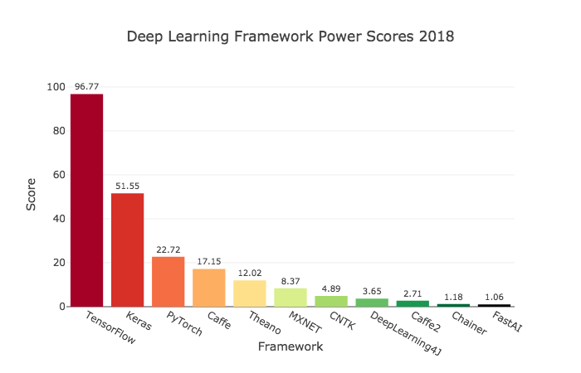
Why is Keras ?

Slide 5
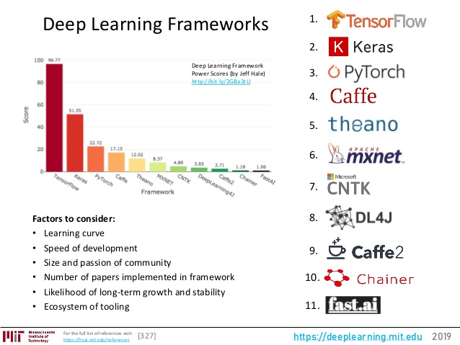
Keras – 更簡潔，更簡單的API

Slide 6
Getting started with the Keras (1) Sequential model
The Sequential model is a linear stack of layers.
You can create a Sequential model by passing a list of layer instances to the constructor:
Method1 Method2
from keras.models import Sequential
from keras.layers import Dense, Activation
model = Sequential([
Dense(32, input_shape=(784,)),
Activation('relu'),
Dense(10),
Activation('softmax'),
])
from keras.models import Sequential
from keras.layers import Dense, Activation
model = Sequential()
model.add(Dense(32, input_dim=784))
model.add(Activation('relu'))
TensorFlow1.x

Slide 7
Dense
model.add(Dense(32, input_shape=(16,)))
# now the model will take as input arrays of shape (*, 16)
# and output arrays of shape (*, 32)
input output
16
32

Slide 8
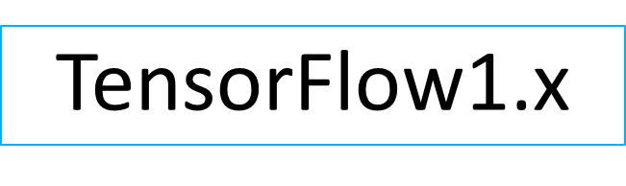
(2) Compilation Method
Before training a model, you need to configure the learning process, which is done via the compile method. It receives three arguments:
# For a multi-class classification problem
model.compile(optimizer='rmsprop', loss='categorical_crossentropy',
metrics=['accuracy'])
# For a binary classification problem
model.compile(optimizer='rmsprop', loss='binary_crossentropy',
metrics=['accuracy'])
# For a mean squared error regression problem
model.compile(optimizer='rmsprop',
loss='mse')
optimizer=‘rmsprop’
‘sgd’
‘adam’
‘adagrad’

Slide 9
Keras optimizer
from keras import optimizers
(1)
rmsp1=optimizers.RMSprop(lr=0.001, rho=0.9, epsilon=None, decay=0.0)
(2) sgd1=optimizers.SGD(lr=0.01, momentum=0.0, decay=0.0, nesterov=False)
(3) adam1=optimizers.Adam(lr=0.001, beta_1=0.9, beta_2=0.999, epsilon=None, decay=0.0, amsgrad=False)
model.compile(loss='mean_squared_error', optimizer=adam1)

Slide 10
(3) Training
Keras models are trained on Numpy arrays of input data and labels. For training a model, you will typically use the fit function.
# Generate dummy data
import numpy as np
data = np.random.random((1000, 100))
labels = np.random.randint(2, size=(1000, 1))
# Train the model, iterating on the data in batches of 32 samples
model.fit(data, labels, epochs=10, batch_size=32)

Slide 11
(4) Evaluate
evaluate(x=None, y=None, batch_size=None, verbose=1, sample_weight=None, steps=None)
Returns the loss value & metrics values for the model in test mode.
verbose: 0 or 1. Verbosity mode. 0 = silent, 1 = progress bar.
Computation is done in batches.
loss,accuracy = model.evaluate(X_train,Y_train, verbose=0)

Slide 12
(5) predict
predict(x, batch_size=None, verbose=0, steps=None)
Generates output predictions for the input samples.
Computation is done in batches. Arguments
The input data, as a Numpy array (or list of Numpy arrays if the model has multiple inputs).
batch_size: Integer. If unspecified, it will default to 32.
• verbose: Verbosity mode, 0 or 1.
steps: Total number of steps (batches of samples) before declaring the prediction round finished. Ignored with the default value of None.
Returns
Numpy array(s) of predictions

Slide 13
TensorFlow 2.0
TensorFlow 2.0 has introduced th standardized version of tf.keras, which combines the simplicity of Keras and power of estimators.
Keras 終於正式整合到TensorFlow 架構當中，開發者不用再另外安裝其他函式庫了直接
from tensorflow.keras.models import Model
就能呼叫 Keras 的 API。或許你可能會問 TensorFlow 跟 Keras 差別在哪裡？簡單來說 Keras 將模型架構包成一個API讓開發者可以快速的搭建網路並呼叫 TensorFlow 底層的架構，簡單來說就是一個簡單的抽象介面。

Slide 14
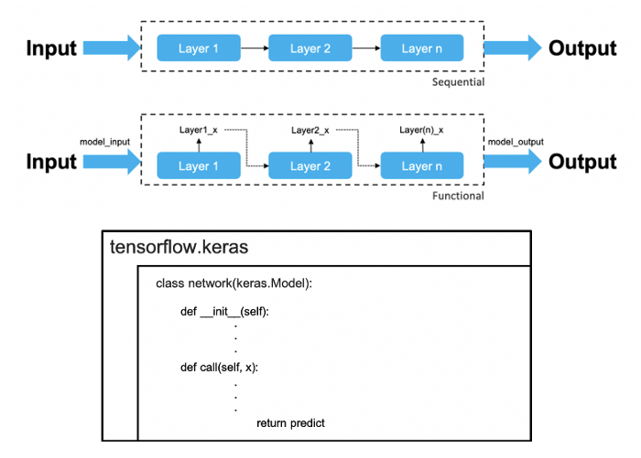
三種快速搭建網路的方式
Sequential API
(2)Functional API
(3)Model Subclassing
TensorFlow 2.x

Slide 15

Sequential API
TensorFlow 2.x
這個寫法 Keras 的用戶應該最為熟悉，我們一層一層有序的(Sequential)搭建神經網路架構。每一層你可以使用 Dense 並設定神經元個數以及 Activation 激發函數，最終變數model中就儲存了我們所設定的網路。
from tensorflow.keras.layers import Dense, Activation
from tensorflow.keras import Sequential
model = Sequential()
model.add(Dense(8, Activation('relu'), input_dim=X.shape[-1]))
model.add(Dense(16, Activation('relu')))
model.add(Dense(3, Activation('softmax')))
Input
data
8
16
3

Slide 16
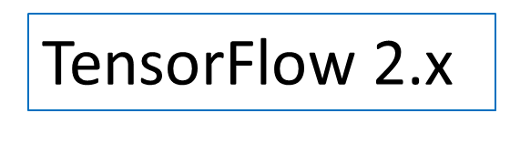
Functional API
此寫法利用函式自定義模型並提供了更靈活的方法。每一層的輸入即為上一層的輸出。這種方法可以更彈性的設定每一層的 input，或是可以自由的修改神經網路的資料流。
from tensorflow.keras import layers
from tensorflow.keras.models import Model
def build_model():
model_input = layers.Input(shape=X.shape[-1])
x = layers.Dense(8,activation='relu')(model_input)
x = layers.Dense(16,activation='relu')(x)
model_output = layers.Dense(3,activation='softmax')(x)
return Model(model_input ,model_output)
主程式
model = build_model()

Slide 17
Complie+fit
model = Sequential()
model.add(layers.Dense(1, activation = ‘relu', input_dim = 784)) model.compile(optimizer=tf.keras.optimizers.RMSprop(lr=0.1), loss='mean_squared_error', metrics=[‘accuracy'])
model.fit(x_train, y_train,batch_size=64,
epochs=15, verbose=0, callbacks=[LearningRateScheduler(lr_schedule)])

Slide 18
Learning rate scheduling
Learning rate scheduling 是一種 adaptive learning rate 的方法，主要的觀察是當 training epochs 增加時，相對應的 learning rate 應該減緩。Learning rate scheduling 則是手動提供 learning rate 減少的時程表。
TensorFlow 2.x

Slide 19
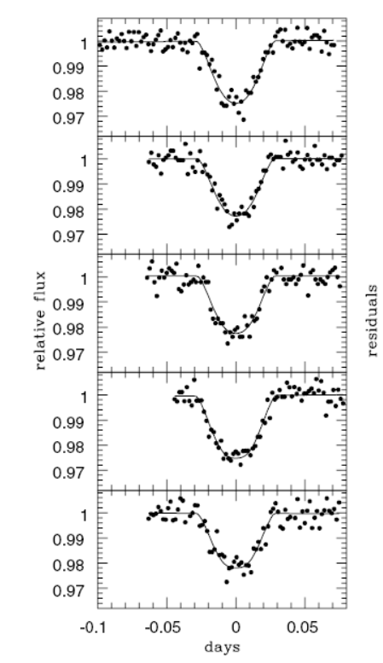
HW1:
(a) 建置另100 曲線 y=0
每個曲線有50個皆為1.0點
+noise ε is random number (-0.1,0.1)
(b)建置另100 曲線 y=1
每個曲線有50個點
任選其中連續5個點降到0.1
其他點皆為1.0
+noise ε is random number (-0.1,0.1)
mp1=100
np1=50
noise1= (2.0*np.random.random((mp1,np1))-1)*0.1
X_train1=np.ones((mp1,np1))+noise1

Slide 20
Two Layers in NN
Y_train1 =np.zeros(mp1)[:,np.newaxis]
Y_train2=np.ones(mp1)[:,np.newaxis]
Input ➔ first layer ➔output
np1 16 1

Slide 21
Example: NN
model = Sequential()
model.add(Dense(16, input_dim=np1))
model.add(Activation(activation='sigmoid'))
model.add(Dense(1))
model.add(Activation(activation='sigmoid'))
adm1=optimizers.Adam(lr=0.001, beta_1=0.9, beta_2=0.999, epsilon=None, decay=0.0, amsgrad=False)
model.compile(optimizer=adm1,loss='binary_crossentropy', metrics=['accuracy'])
model.fit(X_train,Y_train,nb_epoch=100, batch_size=32, verbose=0)
loss,accuracy = model.evaluate(X_train,Y_train, verbose=1)
print ("After Training:")
print ("test loss: {}".format(loss))
print ("test accuracy: {}".format(accuracy))

Slide 22
Ex :change activations
def train_given_act(activation):
model = Sequential()
model.add(Dense(16, input_dim=np1))
model.add(Activation(activation=activation))
model.add(Dense(1))
model.add(Activation(activation='sigmoid'))
model.compile(optimizer='rmsprop', loss='binary_crossentropy',metrics=['accuracy'])
print("Activation",activation)
loss,accuracy = model.evaluate(X_train,Y_train, verbose=0)
print ("After Training:")
print ("test loss: {}".format(loss))
print ("test accuracy: {}".format(accuracy))
train_given_act("relu")
train_given_act("tanh")
train_given_act("sigmoid")
train_given_optimiser("sgd")
train_given_optimiser("rmsprop")
train_given_optimiser("adagrad")
train_given_optimiser("adadelta")
train_given_optimiser("adam")
train_given_optimiser("adamax")
train_given_optimiser("nadam")

Slide 23
1D CNN
Conv1D(filters, kernel_size, strides=1,padding=‘same', activation=‘sigmoid',
input_shape=(np1, 1))
filters: Integer, the dimensionality of the output space (i.e. the number of output filters in the convolution).
•kernel_size: An integer or tuple/list of a single integer, specifying the length of the 1D convolution window.
•strides: An integer or tuple/list of a single integer
•padding: One of "valid" or "same"

Slide 24
1D CNN
X_train = np.expand_dims(X_train, axis=2)
model = Sequential()
model.add(Conv1D(64, 3, activation=‘sigmoid',input_shape=(np1, 1)))
model.add(MaxPooling1D(3))
model.add(Conv1D(128, 3, activation='relu'))
model.add(GlobalAveragePooling1D())
##model.add(Dropout(0.75))
model.add(Dense(1, activation='sigmoid'))
model.compile(loss='binary_crossentropy',
optimizer='adam',
metrics=['accuracy'])
model.fit(X_train, Y_train, batch_size=32, epochs=10)
loss,accuracy = model.evaluate(X_train, Y_train,batch_size=32)
print ("test loss for testdata: {}".format(loss))
print ("test accuracy for testdata: {}".format(accuracy))

Slide 25
Ex1 : 1D-CNN with Two layers
change activations f (ReLu,sigmoid)
Input ➔first layer ➔ second layer ➔output
np1 (f1) 32 (f2) 16 1( sigmoid )
optimizer= ? + epochs=100
Find loss function and accuracy =?
(5) Predict x[2]=x[3]=x[4]=0.1 and other x[i]=1
f1+f2 +optmizer
ReLu+ReLu+’adam’
ReLu+ReLu+’rmsprop’
ReLu+Sigmoid+’adam’
ReLu+Sigmod+’rmsprop’

Slide 26
2D- CNN
Convolution2D(nb_filter, nb_row, nb_col, border_mode=‘same', activation=‘sigmoid', input_shape=(3, 256,256))
nb_filter: Number of convolution filters to use.
•nb_row: Number of rows in the convolution kernel.
•nb_col: Number of columns in the convolution kernel.
border_mode: 'valid', 'same' or 'full'

Slide 27
2D- CNN
# apply a 3x3 convolution with 64 output filters on a 256x256 image:
model = Sequential()
model.add(Convolution2D(64, 3, 3,
border_mode='same',
input_shape=(3, 256, 256)))
# now model.output_shape == (None, 64, 256, 256)
# add a 3x3 convolution on top, with 32 output filters:
model.add(Convolution2D(32, 3, 3, border_mode='same'))
# now model.output_shape == (None, 32, 256, 256)

Slide 28
Ex2 :MNIST: Two Layer
This MNIST dataset is a set of 28×28 pixel grayscale images which represent hand-written digits.
Step 1 :We load the data by running :
from tensorflow.examples.tutorials.mnist import input_data
mnist = input_data.read_data_sets("MNIST_data/", one_hot=True)
Step 2 : Training Data
train_X, train_Y,test_X, test_Y = mnist.train.images, mnist.train.labels, mnist.test.images, mnist.test.labels

Slide 29
import numpy as np
from tensorflow import keras
from tensorflow.keras import layers # Model / data parameters
num_classes = 10
input_shape = (28, 28, 1)
# the data, split between train and test sets
(x_train, y_train), (x_test, y_test) = keras.datasets.mnist.load_data()
# Scale images to the [0, 1] range
x_train = x_train.astype("float32") / 255
x_test = x_test.astype("float32") / 255
# Make sure images have shape (28, 28, 1)
x_train = np.expand_dims(x_train, -1)
x_test = np.expand_dims(x_test, -1)
# convert class vectors to binary class matrices
y_train = keras.utils.to_categorical(y_train, num_classes)
y_test = keras.utils.to_categorical(y_test, num_classes)

Slide 30
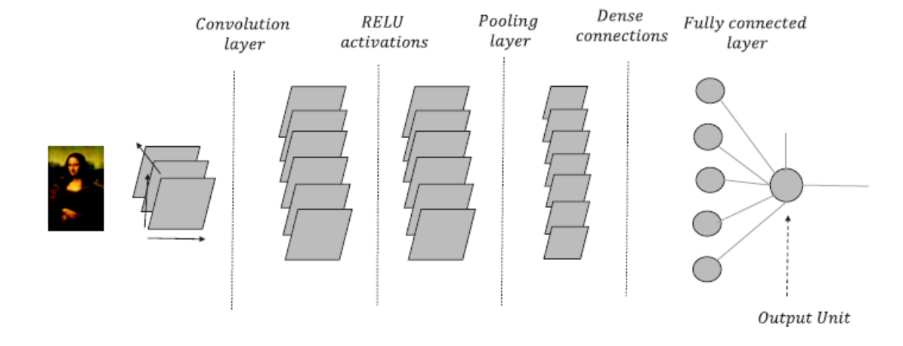
Ex:2D-CNN
import numpy as np
from keras.models import Sequential
from keras.layers import Dense, Activation, Convolution2D, MaxPooling2D, Flatten
from keras.optimizers import Adam

Slide 31
Build 2D-CNN Model
# to build your CNN
model = Sequential()
# Conv layer 1 output shape (32, 28, 28)
model.add(Convolution2D(32, 5,5,
border_mode='same', # Padding method
input_shape=(1, # channels
28, 28,) # height & width
))
model.add(Activation('relu'))
# Pooling layer 1 (max pooling) output shape (32, 14, 14)
model.add(MaxPooling2D(
pool_size=(2, 2),
strides=(2, 2), # 要跳幾個
border_mode='same', # Padding method))

Slide 32
Ex2:2D-CNN
# Convolution layer 2 output shape (64, 14, 14)
model.add(Convolution2D(64, 5, 5, border_mode='same'))
model.add(Activation('relu'))
# Pooling layer 2 (max pooling) output shape (64, 7, 7)
model.add(MaxPooling2D(pool_size=(2, 2), border_mode='same'))
# Fully connected layer 1 input shape (64 * 7 * 7) = (3136), output shape (1024)
model.add(Flatten()) # 把三維的層攤平成一維的
model.add(Dense(1024))
model.add(Activation('relu'))
# Fully connected layer 2 to shape (10) for 10 classes
model.add(Dense(10))
model.add(Activation('softmax'))

Slide 33
Training Model
batch_size = 128
epochs = 15
model.compile(loss="categorical_crossentropy", optimizer="adam", metrics=["accuracy"])
model.fit(x_train, y_train, batch_size=batch_size, epochs=epochs)

Slide 34
Evaluate the trained model
loss,accur = model.evaluate(x_test, y_test,verbose=0)
print("Test loss:", loss)
print("Test accuracy:", accur)

